Slide 1
Discrete-Time Filter Design by Windowing Chapter-7
Content and Figures are from Discrete-Time Signal Processing, 2e by Oppenheim, Shafer, and Buck, ©1999-2000 Prentice Hall Inc.

Slide 2
Filter Design by Windowing
Simplest way of designing FIR filters
Method is all discrete-time no continuous-time involved
Start with ideal frequency response
Choose ideal frequency response as desired response
Most ideal impulse responses are of infinite length
The easiest way to obtain a causal FIR filter from ideal is
More generally

Slide 3
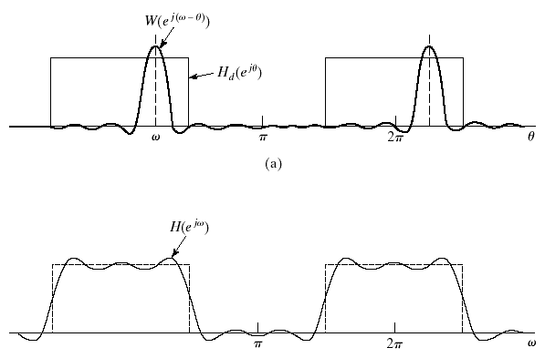
Windowing in Frequency Domain
Windowed frequency response
The windowed version is smeared version of desired response
If w[n]=1 for all n, then W(e^{jω}) is impulse train with 2π period (practically speaking)

Slide 4
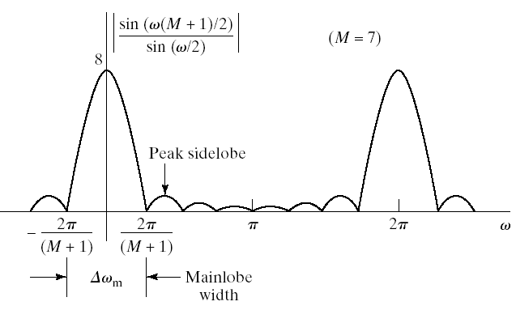
Properties of Windows
Prefer windows that concentrate around DC in frequency
Less smearing, closer approximation
Prefer window that has minimal span in time
computationally efficient
So we want concentration in time and in frequency
Contradictory requirements
Example: Rectangular window

Slide 5
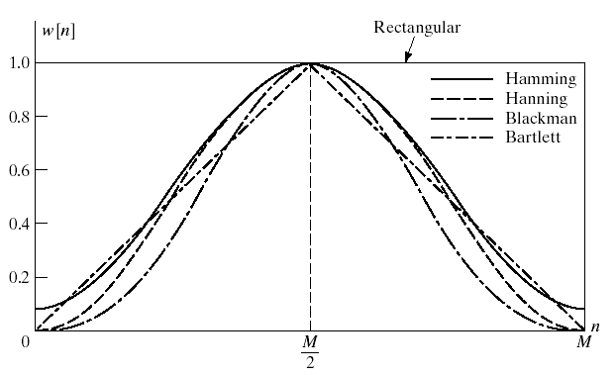
Properties of Windows

Slide 6
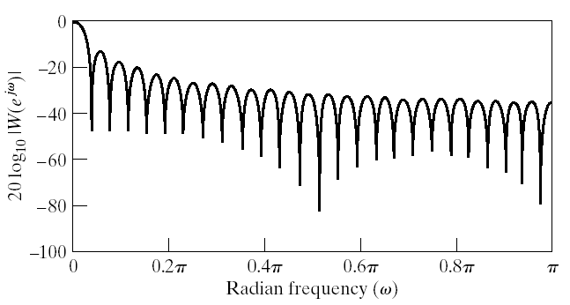
Rectangular Window
Narrowest main lob
4π/(M+1)
Sharpest transitions at discontinuities in frequency
Large side lobs
-13 dB
Simplest window possible

Slide 7
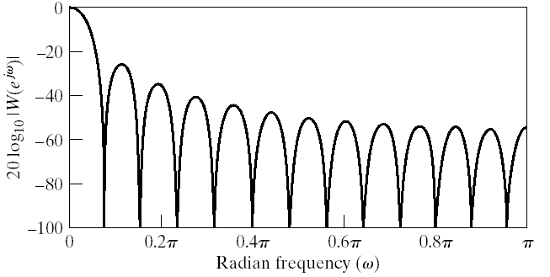
Bartlett (Triangular) Window
Medium main lob
8π/M
Side lobs
-25 dB
Simple equation

Slide 8
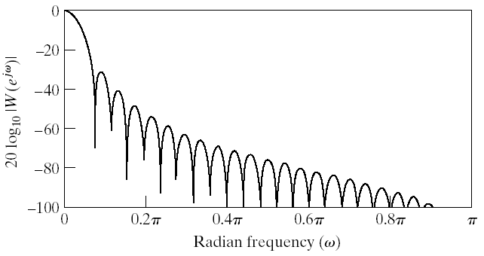
Hanning Window
Medium main lob
8π/M
Side lobs
-31 dB
Equation

Slide 9
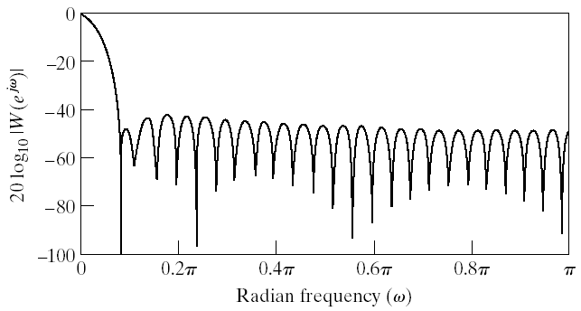
Hamming Window
Medium main lob
8π/M
Good side lobs
-41 dB
Equation

Slide 10
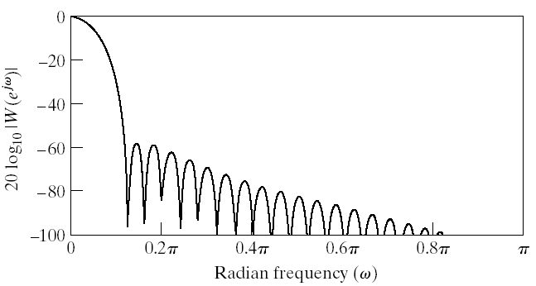
Blackman Window
Large main lob
12π/M
Very good side lobs
-57 dB
Complex equation

Slide 11
Incorporation of Generalized Linear Phase
Windows are designed with linear phase in mind
Symmetric around M/2
So their Fourier transform are of the form

Slide 12
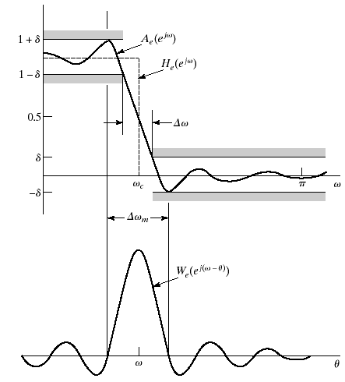
Linear-Phase Lowpass filter
Desired frequency response
Corresponding impulse response
Desired response is even symmetric, use symmetric window

Slide 13
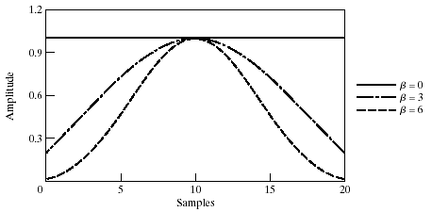
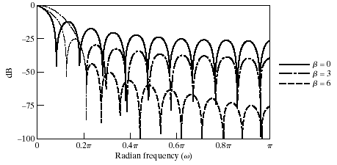
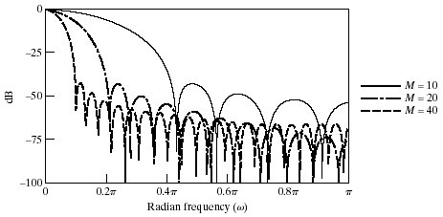
Kaiser Window Filter Design Method
Parameterized equation forming a set of windows
Parameter to change main-lob width and side-lob area trade-off
I₀(.) represents zeroth-order modified Bessel function of 1st kind

Slide 14
Determining Kaiser Window Parameters
Given filter specifications Kaiser developed empirical equations
Given the peak approximation error δ or in dB as A=-20log₁₀ δ
and transition band width
The shape parameter β should be
The filter order M is determined approximately by

Slide 15
Example: Kaiser Window Design of a Lowpass Filter
Specifications
Window design methods assume
Determine cut-off frequency
Due to the symmetry we can choose it to be
Compute
And Kaiser window parameters
Then the impulse response is given as

Slide 16
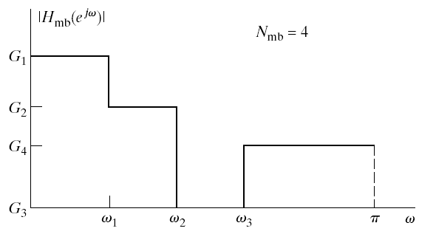
General Frequency Selective Filters
A general multiband impulse response can be written as
Window methods can be applied to multiband filters
Example multiband frequency response
Special cases of
Bandpass
Highpass
Bandstop

